Slide 1
Restaurants in new Delhi
By Sayam Deb

Slide 2
Introduction
New Delhi is an urban district located in the city of Delhi. New Delhi serves as the capital of India and the seat of all three branches of the Government of India.
The city itself has a population of 257,803. New Delhi is a cosmopolitan city due to the multi-ethnic and multi-cultural presence of the vast Indian bureaucracy and political system. The National Capital Region is a much larger entity comprising the entire NCT along with adjoining districts in neighbouring states. The official language of New Delhi and the one that is most widely spoken is Hindi. However, English is also spoken as a formal language within businesses and government agencies. New Delhi is the largest commercial city in northern India.

Slide 3
It has an estimated net State Domestic Product (FY 2010) of ₹1,595 billion (US$22 billion) in nominal terms and ₹6,800 billion (US$95 billion) in PPP terms. As of 2013, the per capita income of Delhi was Rs. 230000, second highest in India after Goa. GSDP in Delhi at the current prices for 2012–13 is estimated at Rs 3.88 trillion (short scale) against Rs 3.11 trillion in 2011–12. Connaught Place, one of North India's largest commercial and financial centres, is located in the northern part of New Delhi.
With its diverse culture, comes diverse food items. There are many restaurants in New Delhi City, each belonging to different categories like Chinese, Italian, French etc. So as part of this project, we will list and visualize all major parts of New Delhi City.

Slide 4
OBJECTIVES
Questions that can be asked using the above mentioned datasets
1) What places have the best restaurants in Delhi?
2) What places have the worst restaurants in Delhi?
3) What is best location in New Delhi City for Chinese Cuisine?
4) Which all areas have less number of restaurant?
5) Which areas have large number of Restaurants available in the locality of New Delhi Market?

Slide 5
DATA requirements
New Delhi restaurants data that contains list Locality, restaurant name, rating along with their latitude and longitude. The data that we are going to need to help us make this project are:
1) Data source: Zomato kaggel dataset: https://www.kaggle.com/shrutimehta/zomatorestaurants-data Description: This data set contains the required information and we will use this data set to explore various locality of New Delhi City. All the nearby places in each locality of new Delhi city will be listed and visualized.
2) Data source: Foursquare API: https://developer.foursquare.com/ Description: By using this API we will get all the exact coordinates of the venues in each neighbourhood.

Slide 6
Approach
1) Collect data from the already prepared dataset of zomato kaggel dataset.
2) Mark all nearby neighbourhoods with the help of Foursquare API.
3) Perform Data Filtering on the acquired random data.
4) Take an aggregate rating in order to solve the business problems.
5) List and Visualize the ranking of the restaurants according to the business problems.

Slide 7
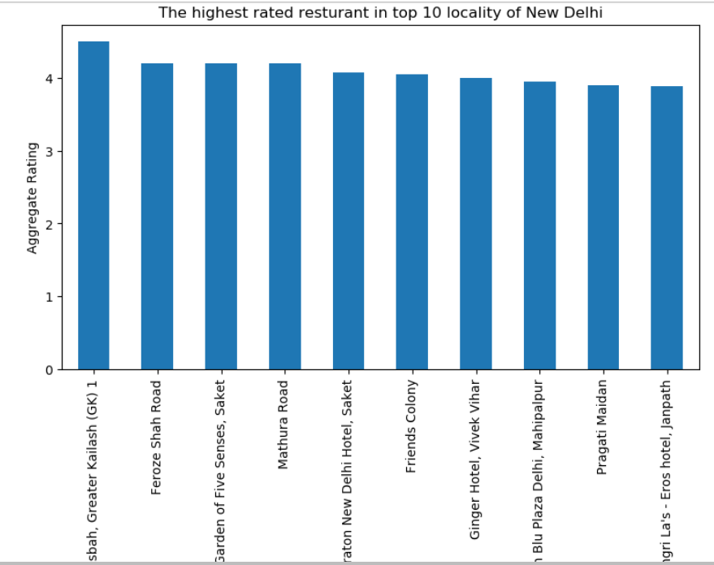
RESULTS

Slide 8
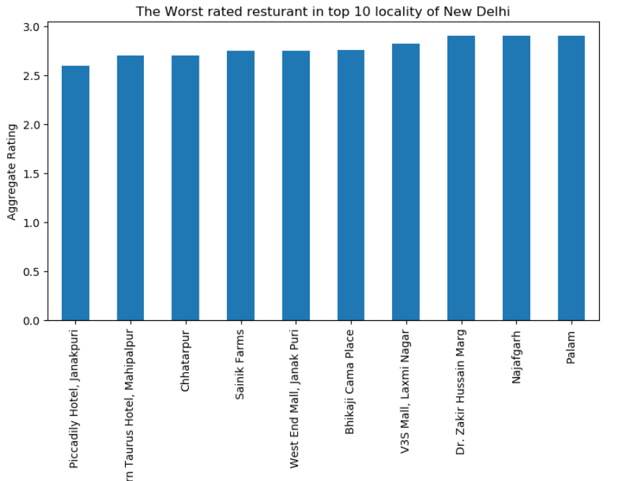

Slide 9
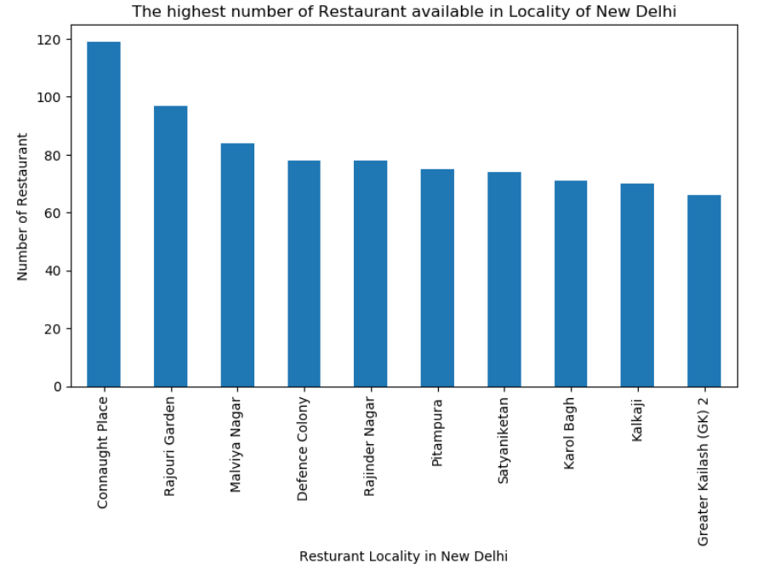

Slide 10
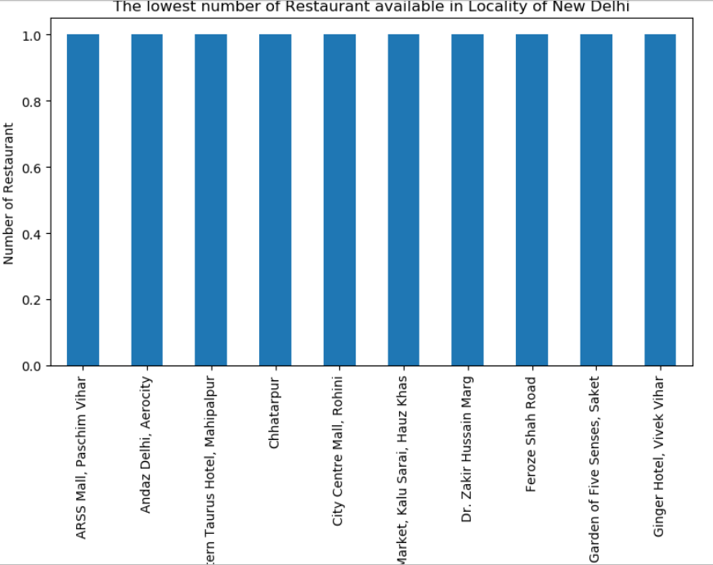

Slide 11
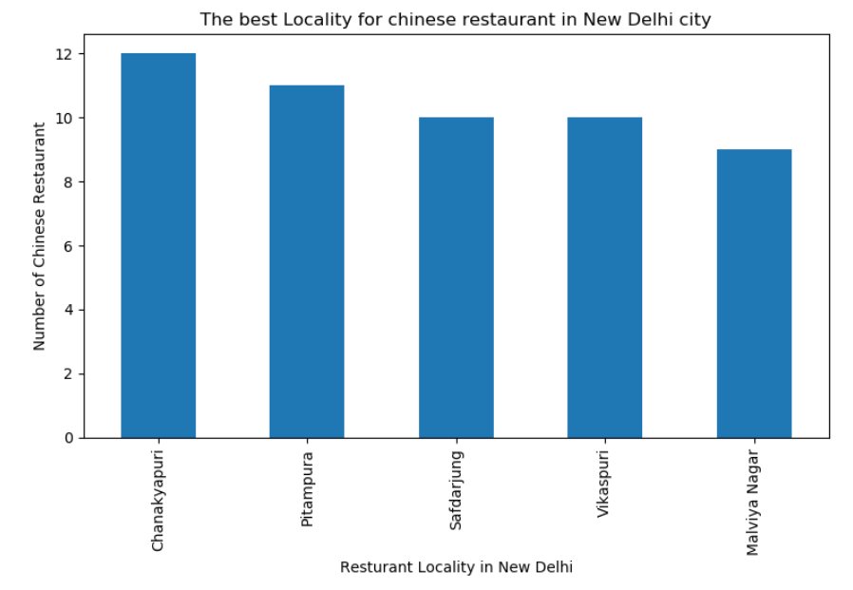

Slide 12
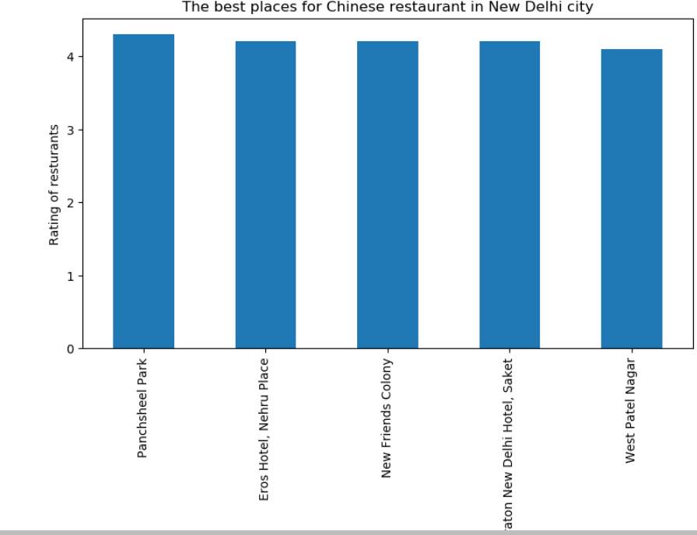

Slide 13
CONCLUSIONS
THE BEST RATED RESTAURANTS ARE AVAILABLE IN KASBAH, GREATER KAILASH(GK).
THE WORST RATED RESTAURANTS IN DELHI ARE IN PICCADILY HOTEL, JANAKPURI.
THE HIGHEST NUMBER OF RESTAURANTS ARE AVAILABLE IN CONNAUGHT PLACE.
THE LOWEST NUMBER OF RESTAURANTS ARE AVAILABLE IN ARSS MALL.
THE BEST LOCALITY FOR CHINESE RESTAURANT IS CHANAKYAPURI.
THE BEST PLACE FOR CHINESE RESTAURANT IS PANCHSHEEL PARK.

